Slide 1
DIGITAL PORTFOLIO
Name :N. Gandhimathi
Class : II BCA – A
Roll no : M24311
M.M.E.S women’s arts and science college,melvisharam.
Thiruvalluvar university

Slide 2
Problem statement :
Traditional portfolios (paper-based) are bulky, hard to share, and difficult to update. Lack of a centralized platform to showcase academic, professional, and creative achievements. Students and professionals face challenges in presenting skills and competencies effectively to recruiters or institutions. Recruiters/employers struggle with verifying and assessing candidate competencies beyond resumes. Limited global reach and accessibility with conventional portfolio methods. Absence of interactive and multimedia elements to reflect true potential.

Slide 3
Project overview :
A Digital Portfolio is an online platform to present skills, academic records, and projects in an organized way. It allows easy access, real-time updates, and interactive presentation of professional achievements. The project demonstrates how an individual can create a strong personal brand identity.

Slide 4
End user :
1. Students – Showcase projects, achievements, and skills (e.g., a CS student showing coding projects and certificates). 2. Job Seekers/Professionals – Highlight experience and work samples (e.g., a designer sharing creative works). 3. Employers/Recruiters – Quickly review skills and verify projects via portfolio links. 4. Educators/Institutions – Track student growth and present profiles during placements.

Slide 5
Tools and technologies :
1. Frontend:HTML, CSS, JavaScript for structure, style, and interactivity.Bootstrap / React for responsive and modern UI .
2. Backend (if used):Node.js / PHP / Django for server-side logic and data handling.
3. Database:MySQL / MongoDB to store user data or portfolio content.
4. Design Tools:Figma / Canva for layout and UI mockups.
5. Version Control & Hosting:Git & GitHub for code management.GitHub Pages / Netlify / Vercel for deployment.

Slide 6
Portfolio design and layout :
1. Home Page – Personal intro, tagline, and quick links. 2. About Me – Career objective, skills, and background. 3. Projects – Showcase with descriptions, screenshots, and GitHub links. 4. Resume/CV – Downloadable version for quick access. 5. Contact Page – Email, form, and social media links. 6. Design Style – Clean, responsive, user-friendly layout with consistent color theme.

Slide 7
Features and functionality :
Responsive Design – Works smoothly on desktop, tablet, and mobile. Interactive Projects Section – Showcases projects with descriptions, images, and GitHub/live links. Downloadable Resume – Easy access for recruiters and employers. Contact Form – Allows direct communication via email. Social Media Integration – Links to LinkedIn, GitHub, and other profiles. User-Friendly Navigation – Clean menu and smooth page transitions. Optional Add-ons – Blog section, certifications, or achievements display.

Slide 8
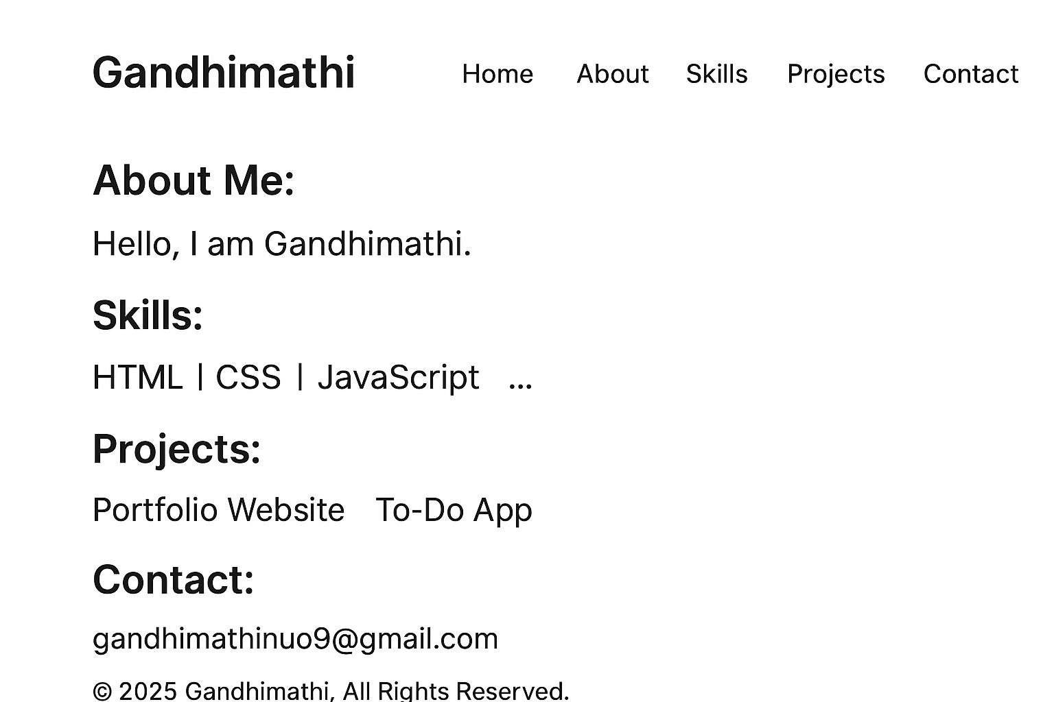
Results :
Successfully developed a responsive and interactive digital portfolio website. Provides a structured way to present personal details, skills, and projects. Recruiters and employers can easily access projects, resumes, and contact details. The portfolio improves personal branding, accessibility, and professionalism.

Slide 9
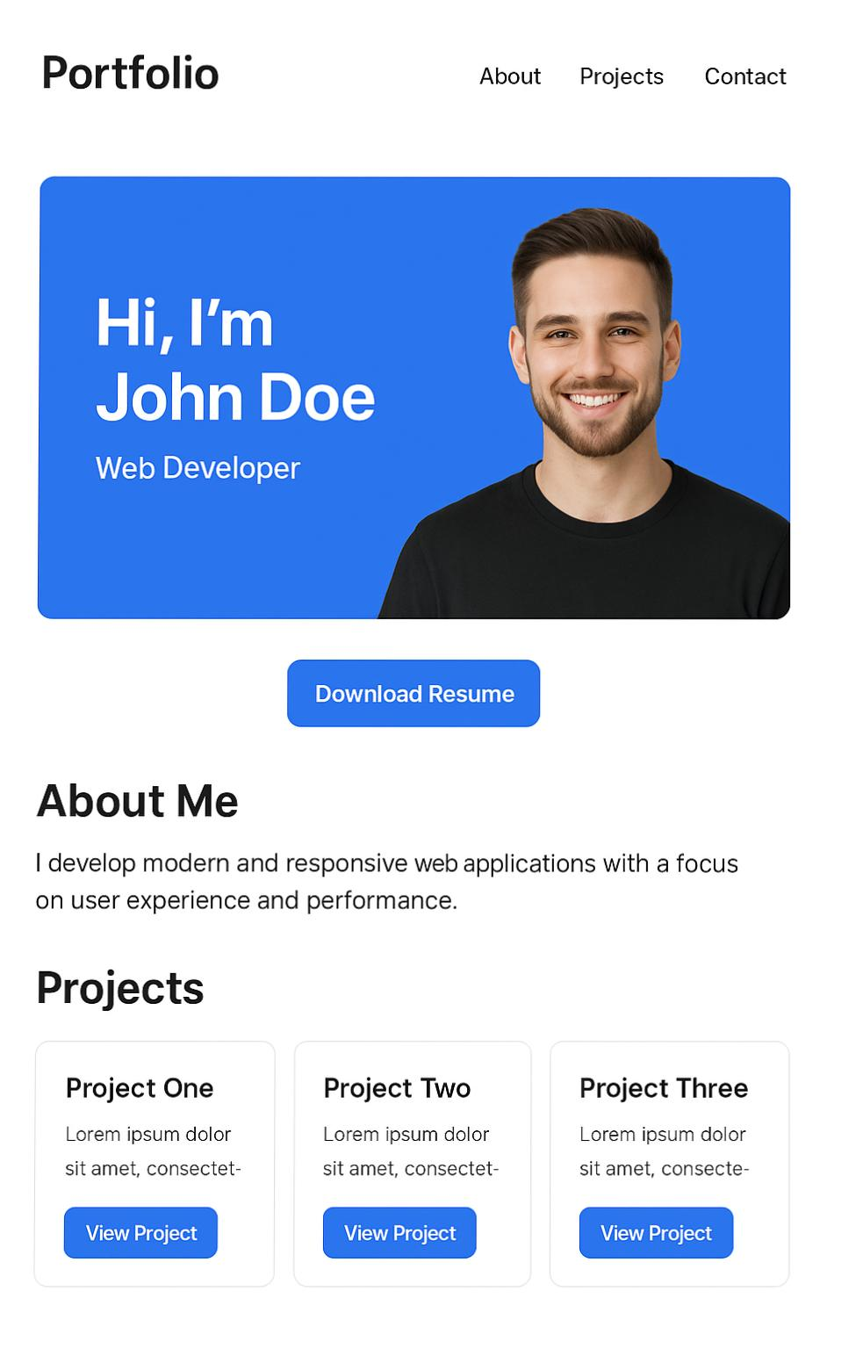
Screenshot :
------------------------------------------------- | Gandhimathi | | Home | About | Skills | Projects | Contact | ------------------------------------------------- | About Me: Hello, I am Gandhimathi... | | Skills: HTML | CSS | JavaScript | ... | | Projects: Portfolio Website | To-Do App | | Contact: gandhimathinuo9@gmail.com | ------------------------------------------------- | © 2025 Gandhimathi. All Rights Reserved. | -------------------------------------------------

Slide 10
Conclusion :
The project demonstrates how a digital portfolio can effectively showcase skills, projects, and achievements. It provides greater accessibility, interactivity, and professionalism compared to traditional resumes. Helps students and professionals build a strong personal brand in the digital space. Can be easily updated, expanded, and enhanced with new features in the future.

Slide 11
Github link :
GitHub Link
🔗 https://github.com/gandhimathi/digital-portfolio

Slide 12

Thank you :

